Slide 1
File Handling in C
Md. Alamgir Hossain
Senior Lecturer,
Dept. of CSE, Prime University, Dhaka
Mail: alamgir.cse14.just@gmail.com

Slide 2

File Handling
A file is a container in computer storage devices used for storing data.
When a program is terminated, the entire data is lost. Storing in a file will preserve your data even if the program terminates.
If you have to enter a large number of data, it will take a lot of time to enter them all.
However, if you have a file containing all the data, you can easily access the contents of the file using a few commands in C.
You can easily move your data from one computer to another without any changes.

Slide 3

Types of Files
Text files:
Text files are the normal .txt files. You can easily create text files using any simple text editors such as Notepad.
When you open those files, you’ll see all the contents within the file as plain text. You can easily edit or delete the contents.
They take minimum effort to maintain, are easily readable, and provide the least security and takes bigger storage space.
Binary files:
Binary files are mostly the .bin files in your computer.
Instead of storing data in plain text, they store it in the binary form (0’s and 1’s).
They can hold a higher amount of data, are not readable easily, and provides better security than text files.

Slide 4
File Operations
In C, you can perform four major operations on files, either text or binary:
Creating a new file
Opening an existing file
Closing a file
Reading from and writing information to a file

Slide 5
Functions for File Handling
Function | Description
fopen() | opens new or existing file
fprintf() | write data into the file
fscanf() | reads data from the file
fputc() | writes a character into the file
fgetc() | reads a character from file
fclose() | closes the file
fseek() | sets the file pointer to given position
fputw() | writes an integer to file
fgetw() | reads an integer from file
ftell() | returns current position
rewind() | sets the file pointer to the beginning of the file

Slide 6
Opening File: fopen()
We must open a file before it can be read, write, or update. The fopen() function is used to open a file. The syntax of the fopen() is given below.
FILE *fopen( const char * filename, const char * mode );
The file name (string). If the file is stored at some specific location, then we must mention the path at which the file is stored. For example, a file name can be like “H://CPP_Program/some_file.txt”.
The mode in which the file is to be opened. It is a string.

Slide 7
Modes in the fopen() function
Mode | Description
r | opens a text file in read mode
w | opens a text file in write mode
a | opens a text file in append mode
r+ | opens a text file in read and write mode
w+ | opens a text file in read and write mode
a+ | opens a text file in read and write mode
rb | opens a binary file in read mode
wb | opens a binary file in write mode
ab | opens a binary file in append mode
rb+ | opens a binary file in read and write mode
wb+ | opens a binary file in read and write mode
ab+ | opens a binary file in read and write mode

Slide 8
Closing a File
The file (both text and binary) should be closed after reading/writing.
Closing a file is performed using the fclose() function.
fclose(fptr); Here, fptr is a file pointer associated with the file to be closed.

Slide 9
Reading and writing to a text file
For reading and writing to a text file, we use the functions fprintf() and fscanf().
They are just the file versions of printf() and scanf(). The only difference is that fprintf() and fscanf() expects a pointer to the structure FILE.

Slide 10
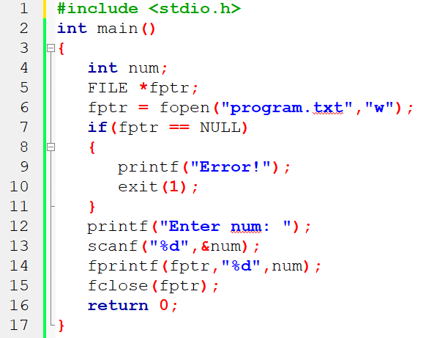
Example 1: Write to a text file
This program reads the integer present in the program.txt file and prints it onto the screen.

Slide 11
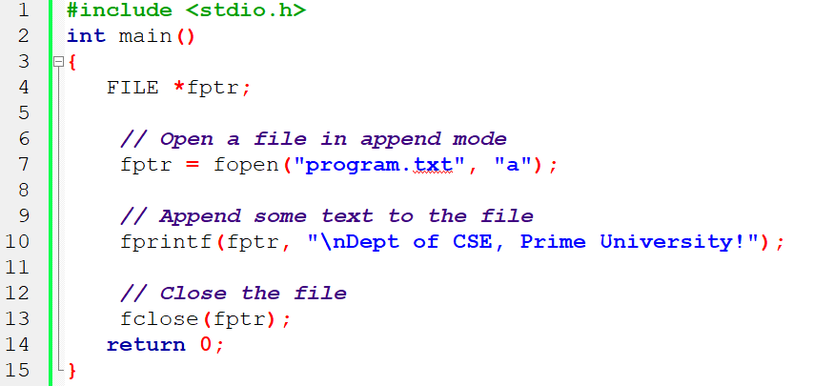
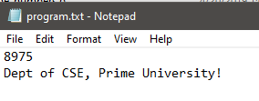
Append to the Text File

Slide 12
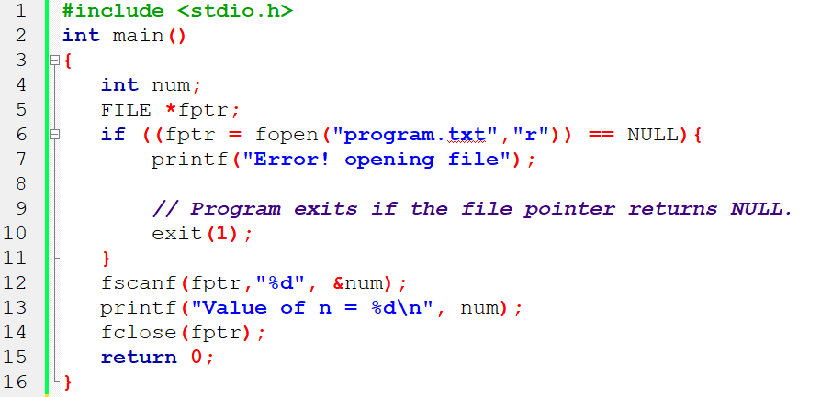
Read Data from the File

Slide 13
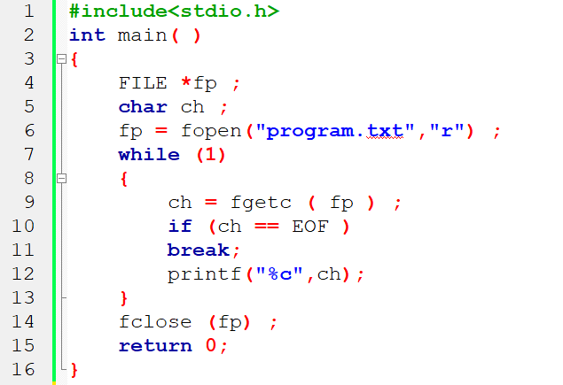
Read Data from the File

Slide 14
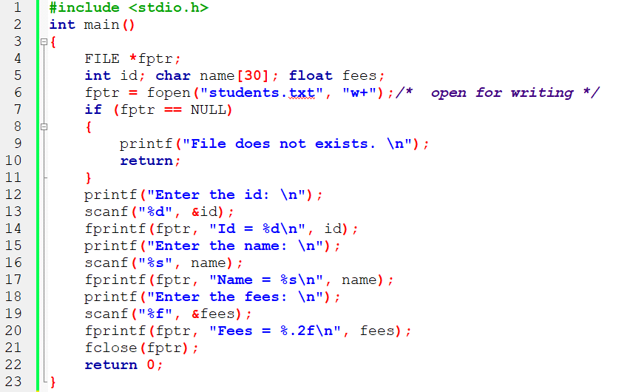
Store Student Information

Slide 15
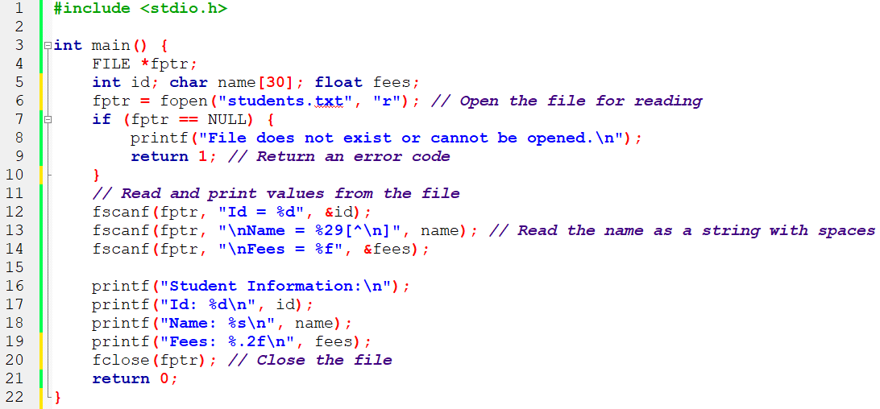
Read Student Information

Slide 16
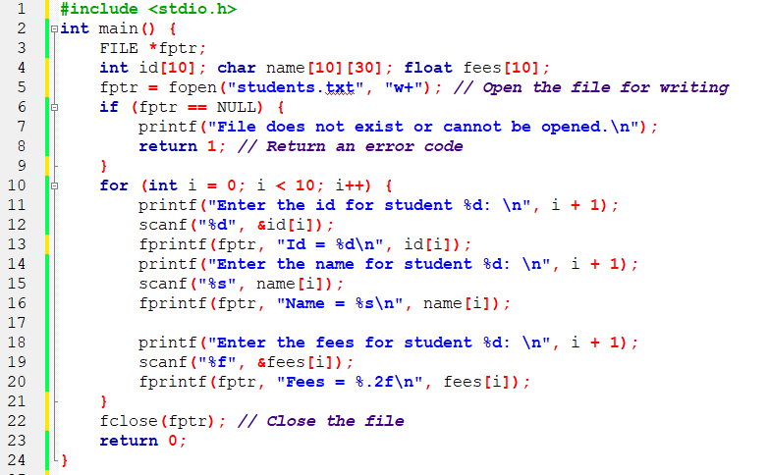
Write Student Information (Array)

Slide 17
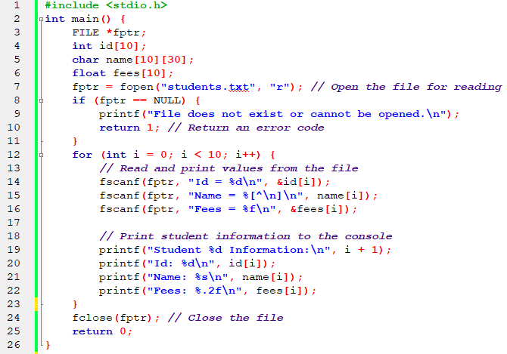
Read Student Information (Array)

Slide 18
*C program that reads a list of numbers from an input file, calculates the sum, average, and product of those numbers, and writes the results to an output file.

Slide 19
Mathematical Operations on Data in a File
1. Create a text file named "numbers.txt" and populate it with a list of numbers, one number per line.
2. Write a C program that performs the following tasks:
Open the “numbers.txt” file for reading.
Read the numbers from the file and store them in an array.
Calculate the sum, average, and product of the numbers.
Open another text file named “results.txt” for writing.
Write the calculated sum, average, and product to the “results.txt” file.
3. Display the results on the console to verify the correctness of the calculations.
4. Implement error handling to handle cases where the input file cannot be opened or other errors occur.

Slide 20
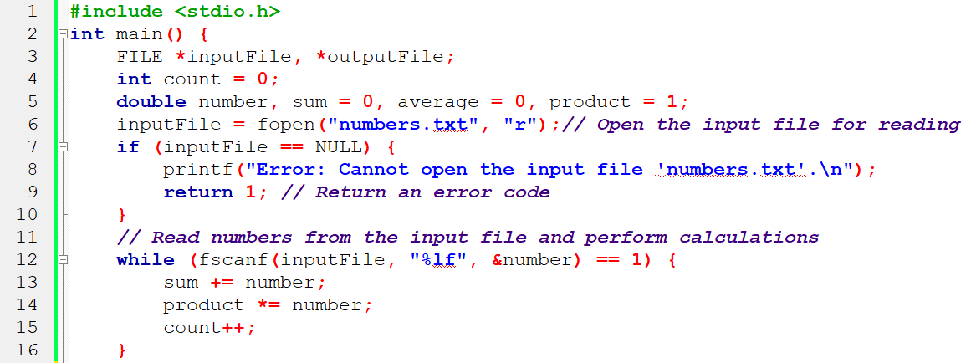
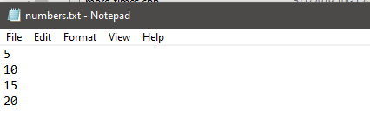

Slide 21
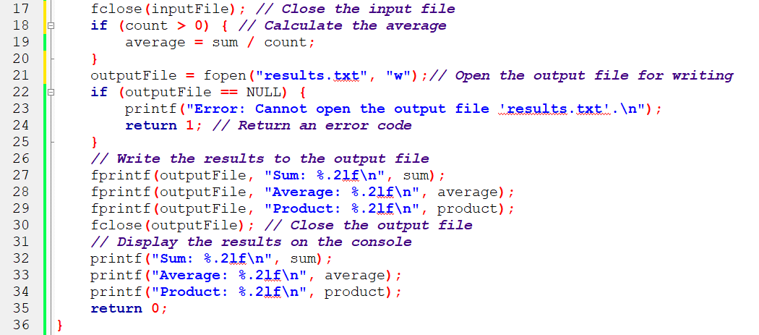
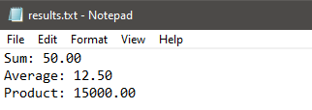

Slide 22
Assignment
1. Create a C program that allows the user to perform the following operations on a text file named “data.txt”:
Add new data to the end of the file.
Display the contents of the file.
Search for specific data in the file and display the matching records.
Modify existing data in the file.
Delete specific data from the file.
2. The program should provide a menu-based interface where the user can choose which operation to perform.
3. When adding new data, ask the user for the necessary information (e.g., ID, name, and value) and append it to the end of the file.
4. When searching for data, ask the user for a search term and display all records that contain the search term.
5. When modifying data, ask the user for the record ID to be modified and then update the relevant data.
6. When deleting data, ask the user for the record ID to be deleted and remove the corresponding record from the file.

Slide 23
Thank You

